Slide 1
On the Implications of the Meltdown & Spectre Design Flaws ISCA 2018 Panel
Mark D. Hill, Wisconsin, CCC, Google Sabbatical
Paul Kocher, Independent
Ruby B. Lee, Princeton & Teleputers
Simha Sethumadhavan, Columbia & Chip Scan
Timothy Sherwood, UCSB & Tortuga Logic

Slide 2
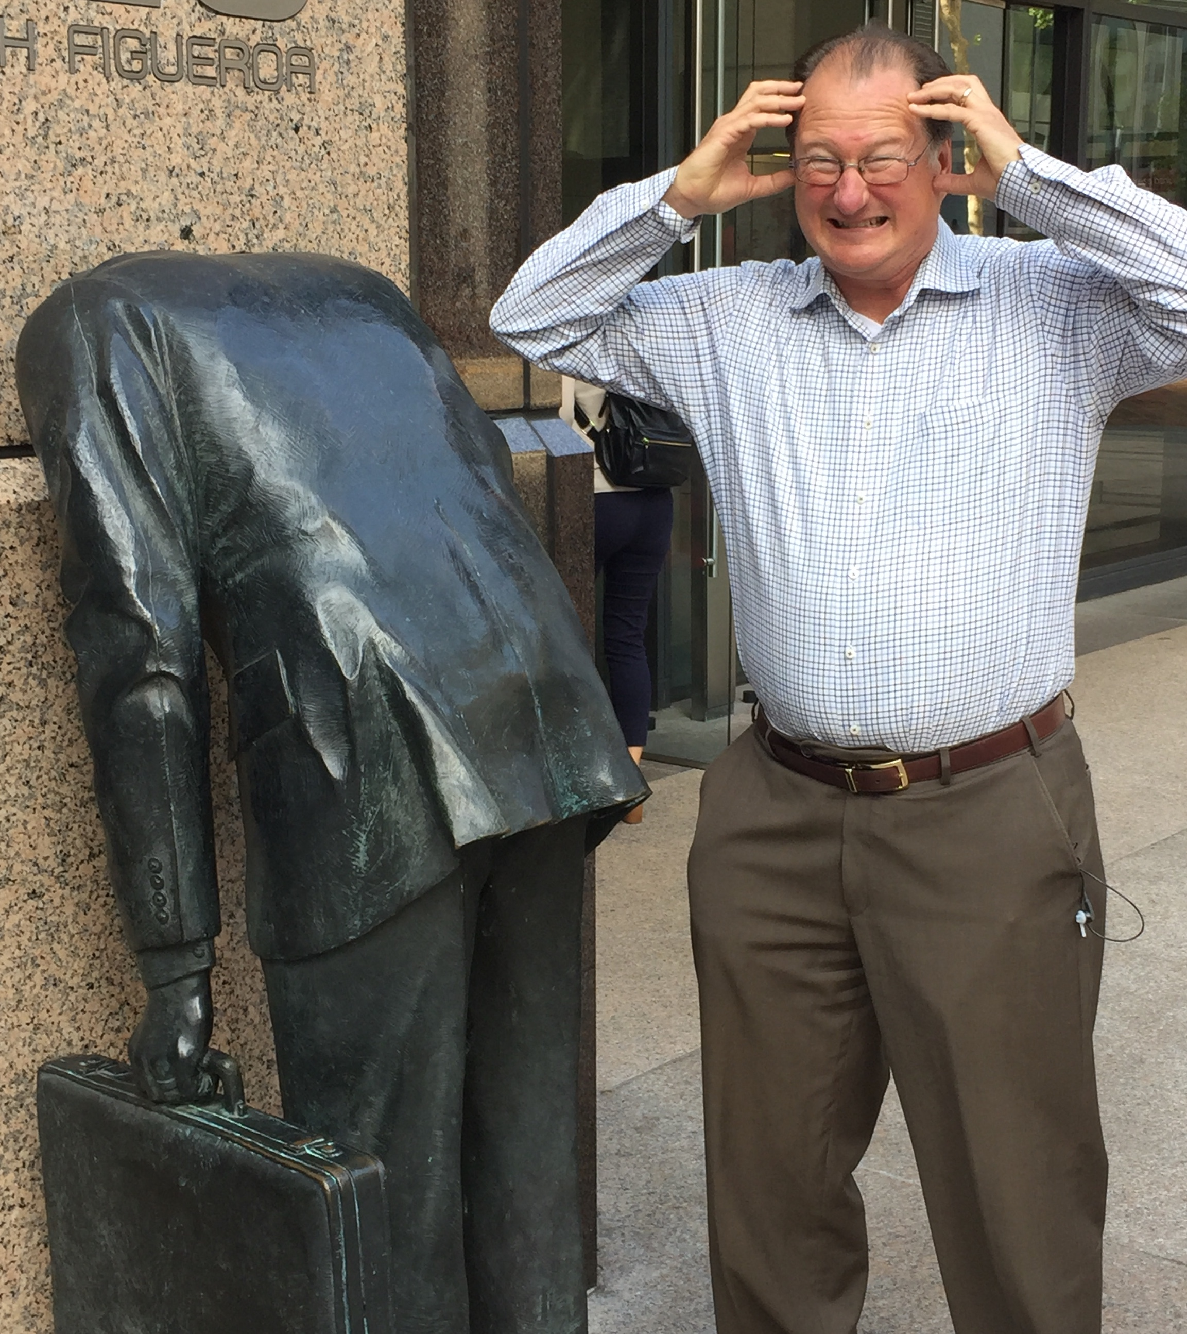
Meltdown & Spectre Announced, January 2018 Photo from Ernst & Young Bldg (across the street)

Slide 3
Panel Info (Hidden Slide)
Panel On the Implications of the Meltdown & Spectre Design Flaws
Computer Architecture 1.0 specifies the timing-independent functional behavior of a computer, while Micro-Architecture is the implementation techniques that improve performance. What if a computer that is completely correct by Architecture 1.0 can be made to leak protected information via timing, a.k.a., Micro-Architecture? This is done by the Meltdown and Spectre design flaws that were broadly revealed in January 2018. Meltdown leaks kernel memory, but software & hardware fixes exist. Spectre leaks memory outside of sandboxes and bounds checks, and it is scary.
This panel will explore implications of Meltdown and Spectre, especially that the definition of Architecture 1.0 is inadequate to protect information.
Going forward, is it time for Architecture 2.0 and, if so, what is it? If not, do we go forward with micro-architecture best practices and, if so, what are they?
Moderator
Mark D. Hill, University of Wisconsin-Madison
Panelists
Paul Kocher, Independent
Ruby B. Lee, Princeton University
Simha Sethumadhavan, Columbia University and Chip Scan Inc.
Timothy Sherwood, UC Santa Barbara and Tortuga Logic
When 12:00pm on Monday June 4, 2018

Slide 4
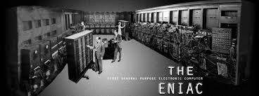
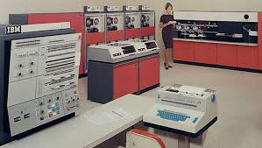
The Set Up
Architecture 0.0: Each computer implementation was new, requiring all software to be rewritten (in machine/assembly language)
Architecture 1.0: the timing-independent functional behavior of a computer Micro-architecture: the implementation techniques to improve performance
Covert timing channels … one process to signal ... another … by modulating its own use of system resources [to be] observed by the 2nd process.
--1983/85 DoD “Orange Book”
ENIAC, etc. mid-20th Century
IBM 360 ISA, 1964

Slide 5

The Problem & Opportunity
Question: What if a computer that is completely correct by Architecture 1.0 can be made to leak protected information via timing, a.k.a., Micro-Architecture?
Meltdown leaks kernel memory, but software & hardware fixes exist
Spectre leaks memory outside of bounds checks or sandboxes, and is scary
Implication: The definition of Architecture 1.0 is inadequate to protect information
Abandon speculation (for accelerators)? Not completely IMHO
Address in micro-architecture? Manage, not fix, like crime
Define Architecture 2.0? Whatever that is

Slide 6
On the Implications of the Meltdown & Spectre Design Flaws ISCA 2018 Panel
Mark D. Hill, Wisconsin, CCC, Google Sabbatical
Paul Kocher, Independent
Ruby B. Lee, Princeton
Simha Sethumadhavan, Columbia & Chip Scan
Timothy Sherwood, UCSB & Tortuga Logic

Slide 7

Spectre & Its Root Causes
Paul Kocher (paul@paulkocher.com)
ISCA
June 4, 2018
If the surgery proves unnecessary, we’ll revert your architectural state at no charge.
All trademarks are the property of their respective owners. This presentation is provided without any guarantee or warranty whatsoever.

Slide 8
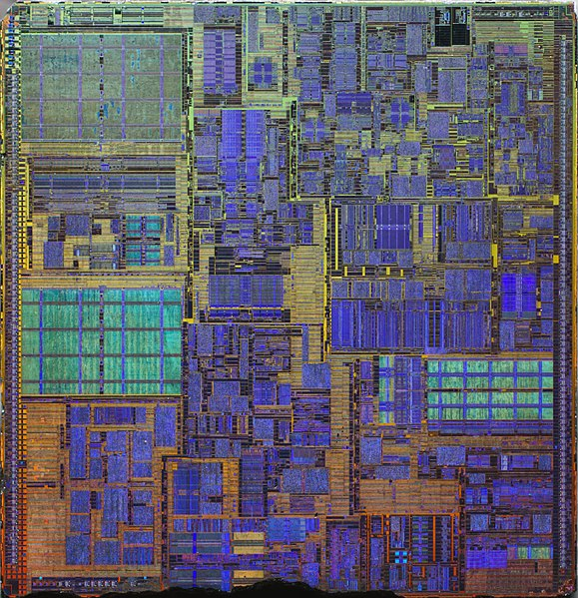
Addicted to speed
Performance goal
Lowest time to reach the result same as running program in-order
Single-thread speed gains require getting more done per clock cycle
Memory latency is slow and not improving much
Clock rates are maxed out: Pentium 4 reached 3.8 GHz in 2004
How to do more per clock?
Reducing memory delays → Caches
Working during delays → Speculative execution
Public domain image of Pentium 4 die by Ritzchens Fritz

Slide 9
Memory caches for dummies
Caches hold local (fast) copy of recently-accessed 64-byte chunks of memory
CPU
Sends address, Receives data
MEMORY
CACHE
MAIN MEMORY
Big, slow
e.g. 16GB SDRAM
Set | Addr | Cached Data ~64B
0 | F0016280 31C6F4C0 339DD740 614F8480 | B5 F5 80 21 E3 2C.. 9A DA 59 11 48 F2.. C7 D7 A0 86 67 18.. 17 4C 59 B8 58 A7..
1 | 71685100 132A4880 2A1C0700 C017E9C0 | 27 BD 5D 2E 84 29.. 30 B2 8F 27 05 9C.. 9E C3 DA EE B7 D9.. D1 76 16 54 51 5B..
2 | 311956C0 002D47C0 91507E80 55194040 | 0A 55 47 82 86 4E.. C4 15 4D 78 B5 C4.. 60 D0 2C DD 78 14.. DF 66 E9 D0 11 43..
3 | 9B27F8C0 8E771100 A001FB40 317178C0 | 84 A0 7F C7 4E BC.. 3B 0B 20 0C DB 58.. 29 D9 F5 6A 72 50.. 35 82 CB 91 78 8B..
4 | 6618E980 BA0CDB40 89E92C00 090F9C40 | 35 11 4A E0 2E F1.. B0 FC 5A 20 D0 7F.. 1C 50 A4 F8 EB 6F.. BB 71 ED 16 07 1F..
Address:
132E1340
Data:
AC 99 17 8F 44 09..
h(addr) to map to cache set
Fast
2A1C0700
Addr: 2A1C0700
Data: 9E C3 DA EE B7 D3..
Addr: 132E1340
Reads change system state:
Next read to newly-cached location is faster
Next read to evicted location is slower
Data: AC 99 17 8F 44 09..
Slow
Addr: 132E1340
Fast
Evict to make room
Data: AC 99 17 8F 44 09..
132E1340
AC 99 17 8F 44 09..

Slide 10
Speculative execution
Instead of idling, CPUs can guess likely program path and do speculative execution
Example:
if (uncached_value_usually_1 == 1)
foo()
Branch predictor: if() will probably be ‘true’ (based on prior history)
CPU starts foo() speculatively -- but doesn’t commit changes
When value arrives from memory, if() can be evaluated definitively -- check if guess was correct:
Correct: Commit speculative work – performance gain
Incorrect: Discard speculative work
Violates software security requirement that the CPUs runs instructions correctly.
Regular execution
Erroneous speculative execution
Set up the conditions so the processor will make a desired mistake
Mistake leaks sensitive data into a covert channel (e.g. state of the cache)
Fetch the sensitive data from the covert channel

Slide 11
Conditional branch (Variant 1) attack
if (x < array1_size)
y = array2[array1[x]*4096];
Assume code in kernel API, where unsigned int x comes from untrusted caller
Execution without speculation is safe
CPU will not evaluate array2[array1[x]*4096] unless x < array1_size
What about with speculative execution?

Slide 12
Conditional branch (Variant 1) attack
if (x < array1_size)
y = array2[array1[x]*4096];
Memory & Cache Status
array1_size = 00000008
Memory at array1 base address:
8 bytes of data (value doesn’t matter) [… lots of memory up to array1 base+N…]
09 F1 98 CC 90...(something secret)
array2[ 0*4096]
array2[ 1*4096]
array2[ 2*4096]
array2[ 3*4096]
array2[ 4*4096]
array2[ 5*4096]
array2[ 6*4096]
array2[ 7*4096]
array2[ 8*4096]
array2[ 9*4096]
array2[10*4096]
array2[11*4096]
Before attack:
Train branch predictor to expect if() is true (e.g. call with x < array1_size)
Evict array1_size and array2[] from cache
Contents don’t matter
only care about cache status
Uncached
Cached
• • •

Slide 13
Conditional branch (Variant 1) attack
if (x < array1_size)
y = array2[array1[x]*4096];
Memory & Cache Status
array1_size = 00000008
Memory at array1 base address:
8 bytes of data (value doesn’t matter) [… lots of memory up to array1 base+N…]
09 F1 98 CC 90...(something secret)
array2[ 0*4096]
array2[ 1*4096]
array2[ 2*4096]
array2[ 3*4096]
array2[ 4*4096]
array2[ 5*4096]
array2[ 6*4096]
array2[ 7*4096]
array2[ 8*4096]
array2[ 9*4096]
array2[10*4096]
array2[11*4096]
Attacker calls victim with x=N (where N > 8)
Speculative exec while waiting for array1_size
Predict that if() is true
Read address (array1 base + x) w/ out-of-bounds x
Read returns secret byte = 09 (fast – in cache)
Request memory at (array2 base + 09*4096)
Brings array2[09*4096] into the cache
Realize if() is false: discard speculative work
Finish operation & return to caller
Attacker measures read time for array2[i*4096]
Read for i=09 is fast (cached), revealing secret byte
Repeat with many x (eg ~10KB/s)
Contents don’t matter
only care about cache status
Uncached
Cached
• • •

Slide 14
Indirect branches (Variant 2)
Can go anywhere instantly (“jmp [rax]”)
Poison predictor so victim speculative executes a ‘gadget’ that leaks memory
Attack steps
Poison branch predictor/BTB so speculative execution will go to gadget
Evict from the cache or do other setup to encourage speculative execution
Execute victim so it runs gadget speculatively
Read sensitive data from covert channel
Repeat
Conditional branch
Is x < y
yes
no
Indirect branch
Jump to address x

Slide 15
Attack scenarios
user process attacks kernel/driver
user process attacks user
intra-process sandbox escape (JavaScript, safe languages…)
user process attacks special modes (SGX/TrustZone/SMM…)
hypervisor guests attack each other/host
remote timing attack
…
Speculation scenarios
conditional branch
indirect jump
return instruction (e.g. Skylake w/ return stack buffer empty)
speculative store bypass
data speculation
…
Variations
Covert channels
Changes in cache state [many variations]
Cache state on entry affects timing of later operations that use shared resources
Other digital (FPU, buffers…)
Analog (power, RF…)
…
Target CPUs
ARM
Intel
AMD
Power
Sparc
…
Many flavors

Slide 16

CPU
Variant 1 Mitigation: Speculation-barrier instruction (e.g. LFENCE)
Idea: Software developers insert barrier on all vulnerable code paths in software
Efficient: No performance impact on benchmarks or other legacy software
Simple & effective
LFENCE
(for CPU developer)… and Variant 2 also messy or no fix
CPU architecture
Machine language
Compiler
Higher-level language
Abstraction boundaries
“All of this is pure garbage”
-- Linus Torvolds
https://lkml.org/lkml/2018/1/21/192
Software
Often millions of control flow paths
Too confusing - speculation runs 188++ instructions, crosses modules
Too risky – miss one and attacker can read entire process memory
operating systems
drivers
web servers
interpreters/JITs
databases
:
Insert LFENCEs manually?
Abysmal performance - LFENCE is very slow (+ no tools)
Not in binary libraries, compiler-created code patterns
Put LFENCES everywhere?
?
Protect all potentially-exploitable patterns = too slow
Compilers judged by performance, not security
Protect only known-bad bad patterns = unsafe
Microsoft Visual C/C++ /Qspectre unsafe for 13 of 15 tests
Insert by smart compiler?
https://www.paulkocher.com/doc/MicrosoftCompilerSpectreMitigation.html
Transfers blame after breach to SW: “you should have put an LFENCE there”
App image: CC0 Creative Commons, Free for commercial use , No attribution required
https://pixabay.com/en/app-software-contour-settings-1013616/

Slide 17





Risk in context
Because of software bugs, computer security was in a dire situation
Spectre doesn’t change the magnitude of the risk, but adds to the mess
Poor mitigation options (fixes -> new risks)
Psychology of unfixed vulnerabilities

Slide 18
Is Spectre a bug?
?!
Everything works according to the textbook
Branch predictor is learning from history, as expected
Speculative execution unwinds architectural state correctly
Reads are fetching data the victim is allowed to read (unlike Meltdown)
Caches are allowed to hold state
Covert channels known to exist (+ very hard to eliminate)
No violation of architecture specs

Slide 19
Architecture ⇔ Software security gap
CPU architectures are under-specified
Confidentiality (cache behavior, predictors, debug modes, power consumption, RF, internal sensors/PLLs…)
Integrity (traditional fault/glitch attacks, RowHammer, clkscrew, supply chain attacks…)
Availability (when can SW degrade performance? crash the system? destroy the CPU?…)
Difficult to specify… and must actually achieve (with high probability)
Software developers forced to rely on microarchitectural guesses
Often wrong today (-> CacheBleed…)
Future chips may be completely different
CPU architectures rely on false assumptions
Assumes SW is perfect -> failure to improve bug survivability (e.g. CFI, CHERI…)
Assumes HW is perfect -> HW security is doomed by excessive complexity
Assumes no trade-offs between security & performance -> can’t maximize both
Assumes architectural ambiguity is OK -> ambiguity is a security problem (not a benign optimization opportunity)

Slide 20
Past: Performance dominated the economics of technology
Today: Costs of insecurity > Value of performance gains
$10¹²-$10¹³ year¹
Magnitude: $10¹¹/year²
Technical challenges
Architecting & implementing robust and resilient systems
Leadership challenge
Today’s leaders developed during 50+ years where performance > security
¹ “Estimating the Global Cost of Cyber Risk” (https://www.rand.org/pubs/research_reports/RR2299.html): $275B-$6.6T direct costs depending on assumptions, and $799B-$22.5T incl. indirect costs.
² My estimate. For reference, Intel’s entire 2017 revenues were $62.8B, ARM <$2B.

Slide 21
Spectre is a symptom
Today it’s crazy to use the same HW+OS for everything
video games + medical + email + wire transfers
Need faster + safer flavors
‘Safer’ = less complex (not just a different mode like TrustZone, Intel SGX)
Accept some inefficiency (performance, die area, power, developer time…)
Faster & safer can co-exist
Common for performance/power: ARM’s big.LITTLE architecture, GPU, TPU
Security examples: Pay TV smart cards, Rambus CryptoManager cores, Apple Enclave…

Slide 22
Thank you!
paul@paulkocher.com

Slide 23
Extra slides

Slide 24
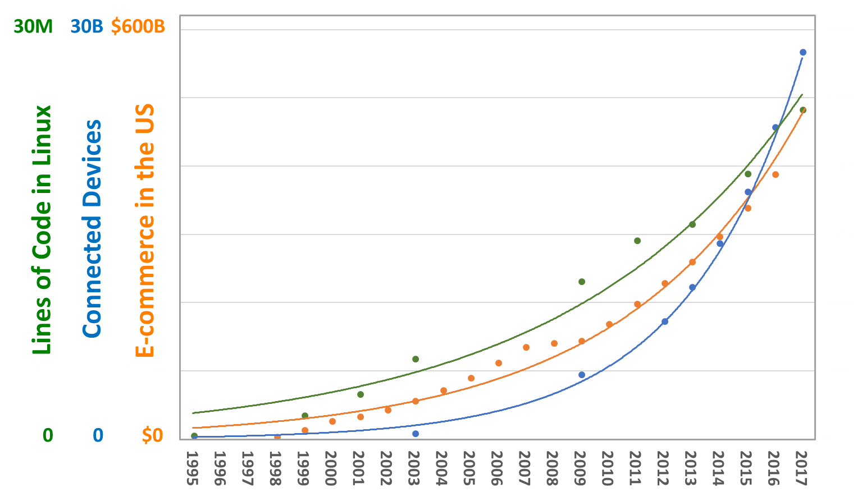
Exponential changes
Attacker perspective:
Complexity → Bugs
Devices → Targets
Economic activity → $

Slide 25
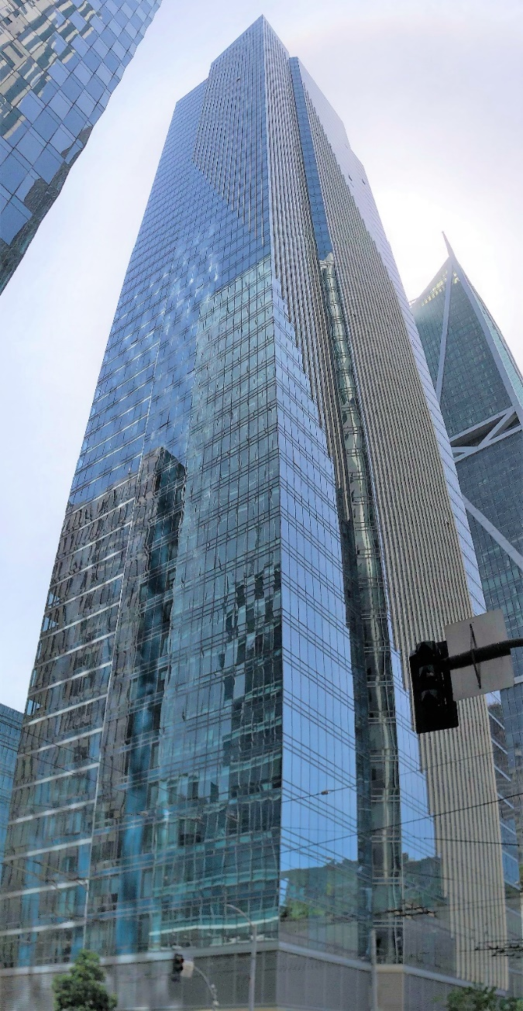
Society
Nation states
Security goals
People
Abstraction creates security challenges
Business objectives
Clouds
Security-critical details hidden in layers
Needs of distant layers unclear
People specialize then miss big picture
Economics don’t fund adequate investment
Risks in other layers deter improvements
Changes aren’t communicated across layers
U.I.
Applications
AI
Libraries/frameworks
Languages
Browsers
Compilers
Abstractions
Dependencies & assumptions
Exponential growth
Operating systems
Protocols
Drivers
Circuit board
CPU architectures
Chip
Microarchitectures
Logic block
Foundations
Transistors

Slide 26

Mitigations: Indirect branch variant
Intel/AMD (x86):
New MSRs created via microcode
Low-level control over branch target buffer (O/S only)
Performance impact – limited use
Retpoline proposal from Google
Messy hack -- replace indirect jumps with construction that resists indirect branch poisoning on Haswell
Microcode updates to make retpoline safe on Skylake & beyond
ARM: No generic mitigation option
Fast ARM CPUs broadly impacted, e.g. Cortex-A9, A15, A17, A57, A72, A73, A75...
Often no mitigation, but on some chips software may be able to invalidate/disable branch predictor (with “non-trivial performance impact”)
See: https://developer.arm.com/support/security-update/download-the-whitepaper
Mitigations are messy (for all Spectre variants + Meltdown)
Software must deal with microarchitectural complexity
Mitigations for all variants are really hard to test
“All of this is pure garbage”
-- Linus Torvolds
https://lkml.org/lkml/2018/1/21/192

Slide 27
ISCA Panel: Architecture 2.0
Ruby B. Lee
Princeton University

Slide 28
Architects need to understand the bigger picture
What are the Fundamental Hardware issues behind Spectre/Meltdown attacks?

Slide 29
Architecture 2.0 Design Approaches
Complete Clean Slate Design - Change everything: programming paradigm, ISA, microarchitecture, etc.
Rethink microarchitecture performance optimization
Optimization through randomization?
Define Design Principles for Security, e.g.,
Access to a different security domain MUST first be checked
Give the attacker NO information

Slide 30
Architecture 2.0
Design Security-Aware Computer Architecture
Yes, Yes, YES!
Grand challenge for architecture creativity:
Rethink performance and security optimization!
through randomization?

Slide 31
We can solve this!
Simha Sethumadhavan
simha@columbia.edu
Simha Sethumadhavan

Slide 32
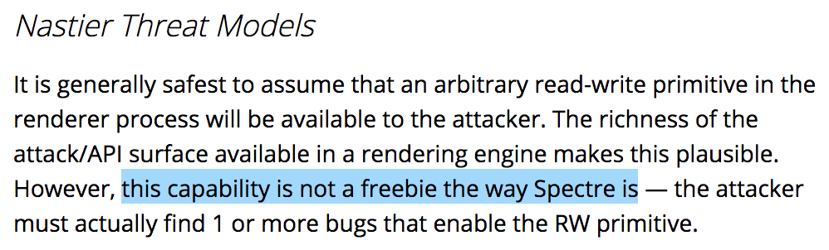
But first, recognize (again) that is a serious problem
Hardware is the root of security and trust. HW compromises will result in catastrophic failures.
Quote from Google Chrome Security Engineering team (May 28th 2018)
Simha Sethumadhavan

Slide 33
We have known about this problem (& solns) for 30+ years
Timing and storage channels occur when two or more processes share a resource in space and/or time. Resource can be any microarchitectural structure: caches, predictors, pipelines, energy mgmt. etc.
Three solution categories
Constant time: Make everything take the same amount of time at microarch level. For instance, add latency = worst case load latency in the system (page fault?). anti comp arch.
Partitioning in time and space: Don’t share and cleanup state after use. High cost due throughput loss (no sharing) and a large number of cold misses (cleanup). anti comp arch.
Randomization: Slow down the attacker. Two types: randomizing time, or randomizing access to shared structures. Low perf overhead but not preferred by security puritans
Simha Sethumadhavan

Slide 34
There is a fourth option that is easy and feasible.
Basic Idea
Punish the attacker not the victim.
Randomization can be secure enough in many contexts.
Simha Sethumadhavan

Slide 35
There is a fourth option that is easy and feasible.
Consider a machine with these three options:
High security but high cost: static partitioning and/or constant time
Low cost but reasonable security: randomization
No cost and no security: normal high performance mode
Determine threat using a predictor (basically an anomaly detector with one sided error) to determine threat level.
Move to safe mode when threat is detected or in randomization mode, switch to high security (or change application keys) when entropy runs out.
We know how to do this. And, this can happen completely without user involvement or programmer support.
Simha Sethumadhavan

Slide 36
Only people in this room can solve this problem
Baby steps
Think about including a security evaluation section in your paper
Pick a less leaky option if you are designing hardware
Say something about security in each computer architecture lecture
The world is really flat (and not in a good way) because of HW 0-days.
Please help stop this.
Simha Sethumadhavan

Slide 37
Timothy Sherwood

Slide 38

“hard” to exploit is not good enough
a tale from Rowhammer
Deterministic Attack
Javascript Interpreter
Browser Process
OS Memory Layout
No user level access to pagemap
Deduplication
Memory pressure manager
Address Space Randomization
Cache Hierarchy
No explicit cache flush
All the stuff we know and love
DRAM Controller, etc.
how long?
2 weeks.

Slide 39
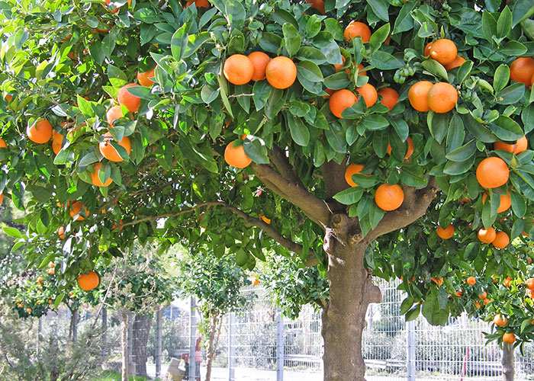
respect the adversary
timing is explicit in hw
new verifiable abstractions
Architecture
Operating System
Application

